Slide 1

Tourism Website
Prepared by ,
Name: Akhani Yash JitendraKumar
Enrollment No: 22002170120002
Sem: III Branch: CE
Batch: F2
Head of Department:
Prof. Ami Patel
HoD, SY CE/IT-II
Faculty Coordinator:
Prof. Rinkal Jain

Slide 2

Abstract:-
Identify the main attractions and destinations in Gujarat that you want to feature on the website. This could include historical sites, cultural landmarks, natural wonders, and popular tourist spots.
Choose a color scheme and design theme that reflects the cultural and natural beauty of Gujarat. You can use Bootstrap and CSS to create a visually appealing and responsive design that works well on all devices.
Use HTML to create a navigation menu that makes it easy for users to find the information they need. Include links to different sections of the website, such as accommodation options, tourist activities etc.
Use JS to add interactive features to the website, such as maps, photo galleries. This will help to engage users and encourage them to explore more of what Gujarat has to offer.

Slide 3
Languages:
HTML (Hypertext Markup Language):- The HTML is the standard markup language for documents designed to be displayed in a web browser.
CSS (Cascading Style Sheets):- Cascading Style Sheets is a style sheet language used for describing the presentation of a document written in a markup language such as HTML or XML. CSS is a cornerstone technology of the World Wide Web, alongside HTML and JavaScript.
BOOTSTRAP:- Bootstrap is a free and open-source CSS framework directed at responsive, mobile-first front-end web development. It contains HTML, CSS and JavaScript-based design templates for typography, forms, buttons, navigation, and other interface components.
JS(JavaScript):- JS, is a programming language that is one of the core technologies of the World Wide Web, alongside HTML and CSS. As of 2022, 98% of websites use JavaScript on the client side for webpage behavior, often incorporating third-party libraries.

Slide 4
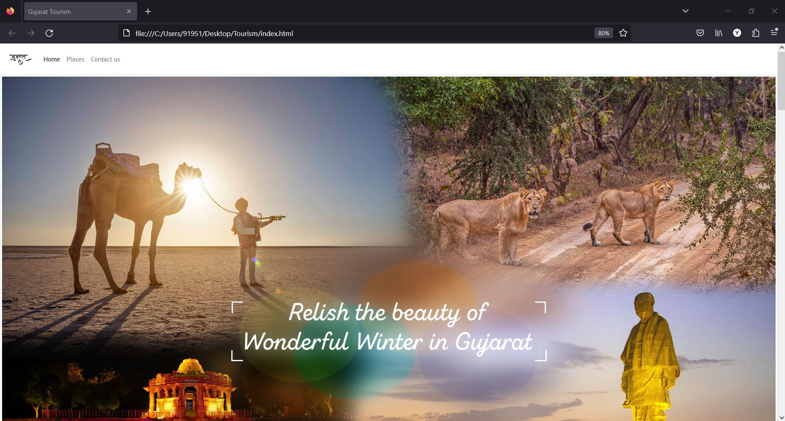
Output:-

Slide 5
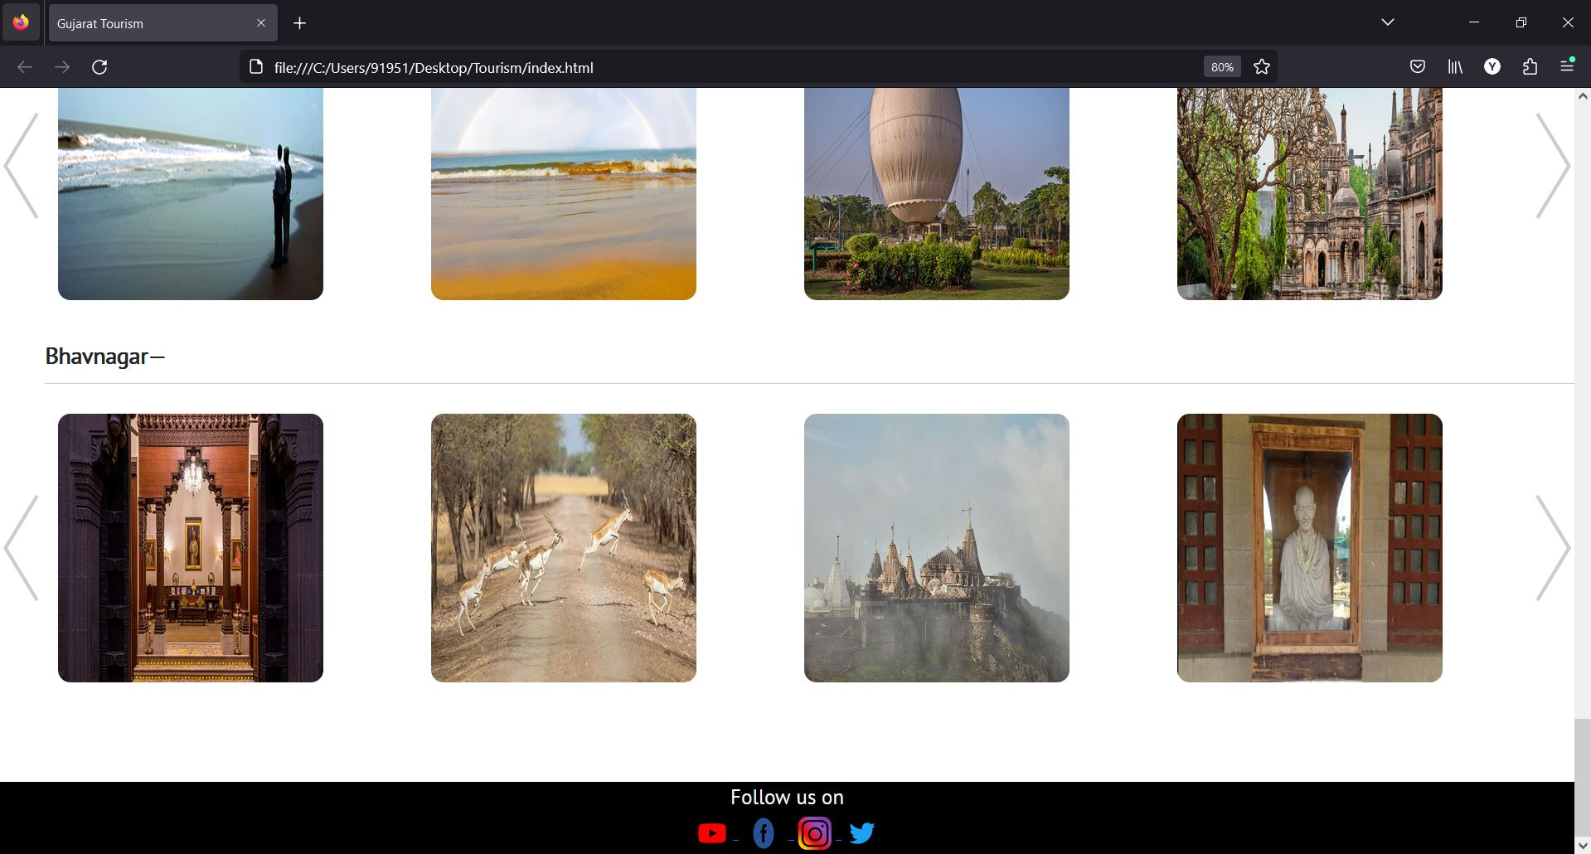
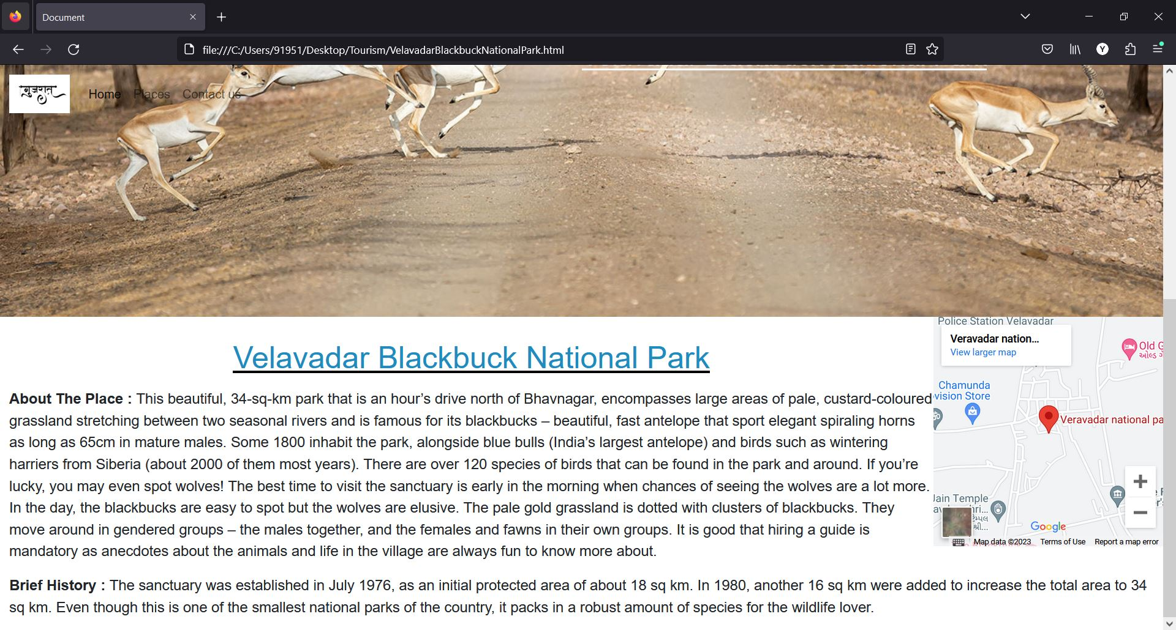
Continue…

Slide 6
References:
IDE:
- VS Code
https://code.visualstudio.com/
Web Browser:
- Firefox
- Microsoft Edge
Websites:
https://www.gujarattourism.com/
https://devdocs.io/javascript/
https://getbootstrap.com/
https://www.w3schools.com/htmL/html_css.asp/

Slide 7
Thank You…

